Slide 1

Life Wealth Dreams
Nutrition Unit 1

Slide 2

Nutrition Unit 1
Goals 1. Understand how to shop at a grocery store
2. Consider food options as it relates to budget, time, and health
3. Read food labels

Slide 3
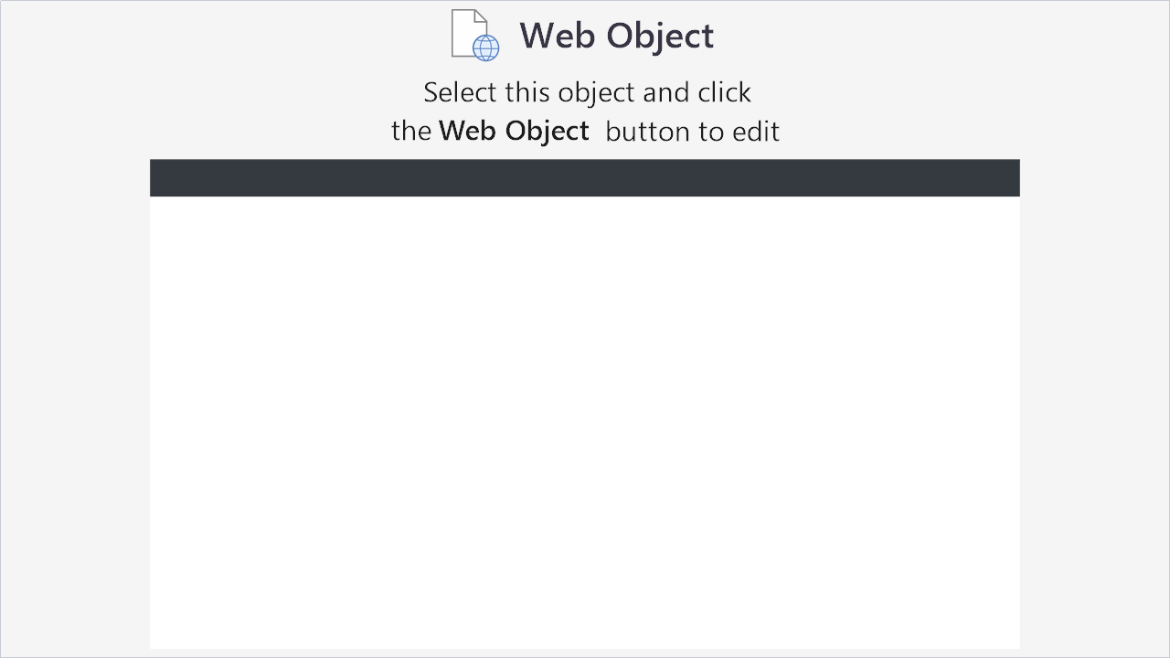

Slide 4
Nutrition Unit 1 Simulation
Choose your focus: Money Time Health

Slide 5
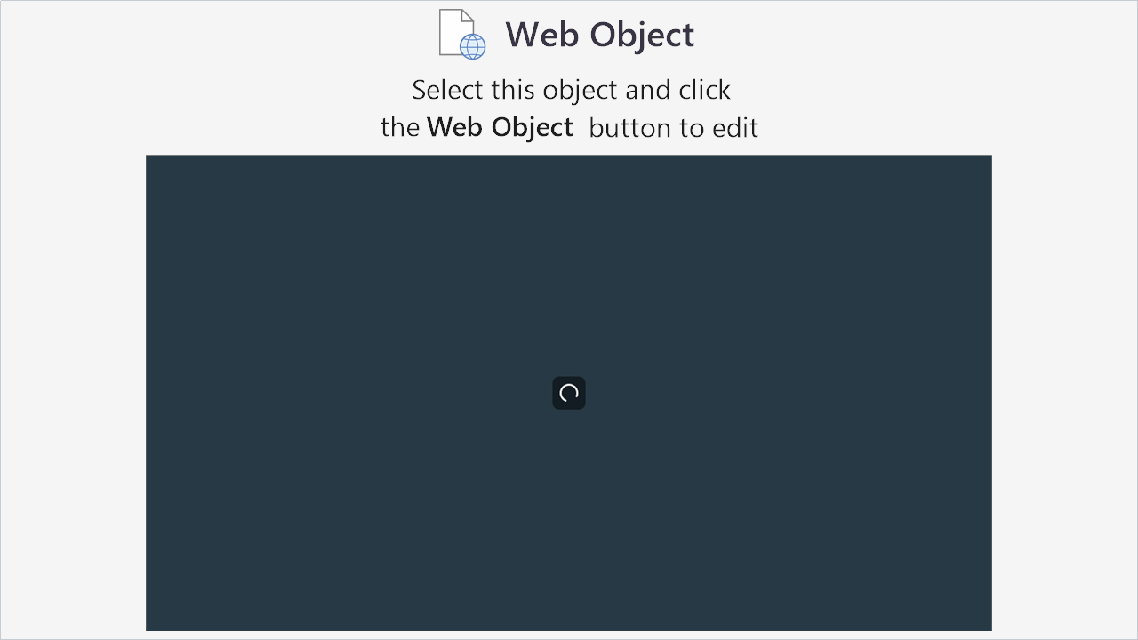

Slide 6
Nutrition Unit 1 Reflection
How does nutrition effect your spending?

Slide 7
Nutrition Unit 1
Please use these tips when shopping at a grocery store.

Slide 8

Helpful Tips
Ask for advice
Eat before you shop
Read the sales flyer
Use Coupons
Look up and down to save
Check for store brands
Join your store’s loyalty program
Please download file

Slide 9
Life Wealth Dreams
Nutrition Unit 1 – Thank you for playing!

